Slide 1
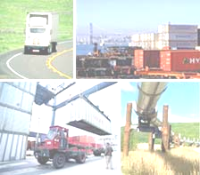
Transportation Logistics
Professor Goodchild
Spring 2011

Slide 2
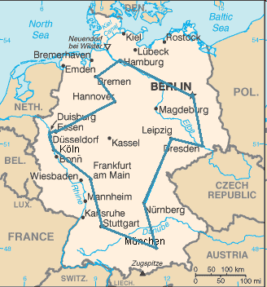
Traveling Salesman Problem
Visit a set of cities and minimize total travel cost
Applies to delivery
routes
Assume travel cost
independent of order
Individual traveler

Slide 3
Traveling Salesman Problem
Can be formulated as an integer programming problem
The time to find an optimal solution increases very quickly with N
Requires location of each city (customer) to be visited

Slide 4
TSP approximation
Is there a formula for L* (the optimum expected length) if N points are randomly scattered (with density δ) in a square region of area A?
L*~k √(AN)=kN/√δ
k depends on the metric (approximately 0.72 for L2 (Euclidean), .92 for L1 (grid))
Works well for large N
Other formulae for different shapes, moderate N

Slide 5
Vehicle Routing Problem
Assume given locations of N points, a depot, a matrix of costs to travel between locations, a demand for each point, a vehicle capacity
Find an allocation of points to vehicles and a set of vehicle routes ending and beginning at the depot that minimizes either vehicle distance, number of vehicles, or a combination of the two
Assumes number of vehicles known

Slide 6
VRP
Can be formulated as an integer program in a variety of ways
The time to find an optimal solution increases very quickly with N
Faster solution methods have been developed that don’t find the optimum but find a good solution
Local search methods (simulated annealing)

Slide 7
TSP approximation
r: distance from depot to center of tour area
D: total demand (units)
v_{m}: vehicle capacity
L_{vrp}≤L_{tsp}+2Dr/v_{m}

Slide 8
Time windows
A time window is an interval in time, provided for the delivery of some good
A narrow time window is a short one, say 30 minutes in length
A wide time window is a long one, say 8 hours in length
How do time windows effect the vehicle routing problem?

Slide 9
Questions
How does the length of a tour change with demand density?
How does the number of drivers change with the length of a tour?
How would you calculate the demand density with 30 minute time windows versus 2 hour time windows?

Slide 10
Tailored Strategies
Tighter time windows for customers that are willing to pay more.
Deliveries outside of peak travel periods.
Allow transportation companies to expand their markets.
Increase logistical complexity.

